Slide 1
KWH Feedback
2024-12-13

Slide 2
2024-12-03

Slide 3
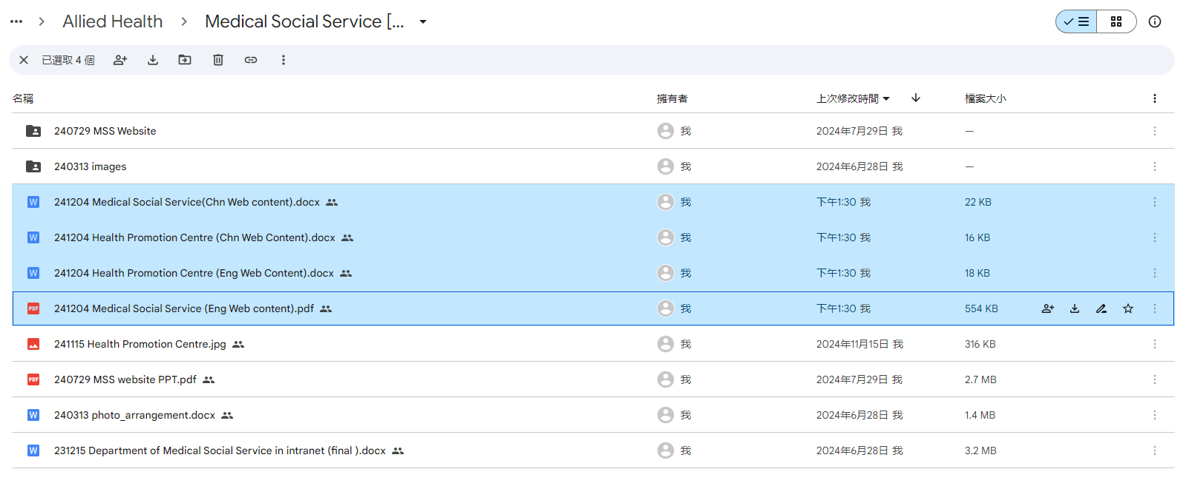
https://kwh.9u1.net/Services/Medical-Social-Service.html
https://kwh.9u1.net/Services/Health-Promotion-Centre.html
done

Slide 4
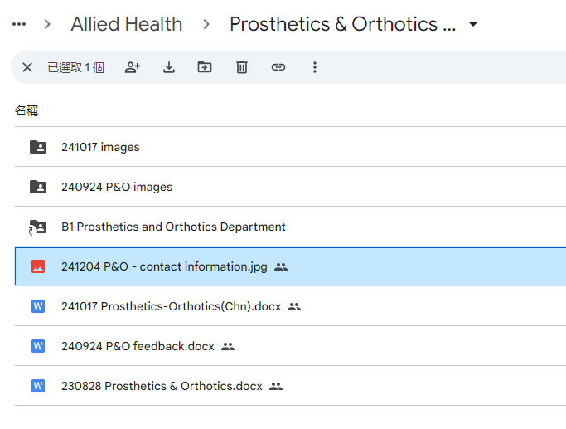
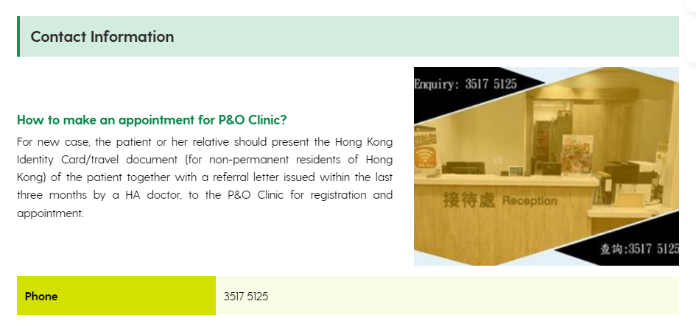
https://kwh.9u1.net/Services/Prosthetics-Orthotics.html
done
更換圖片

Slide 5
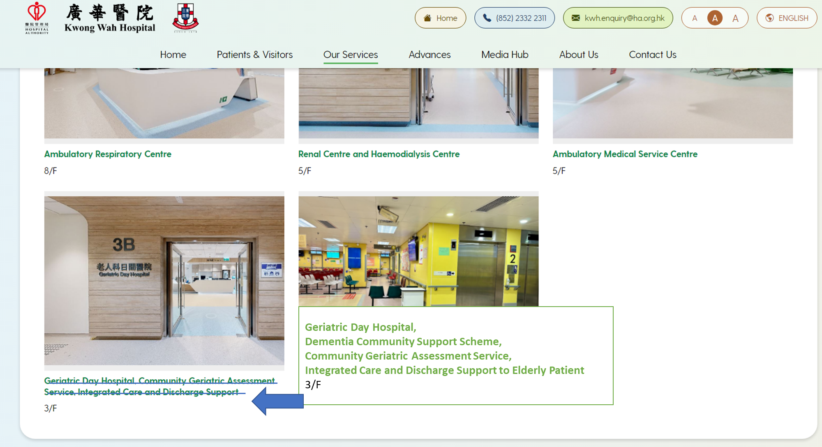
https://kwh.9u1.net/Services/Medicine-And-Geriatrics.html
done
Geriatric Day Hospital,
Dementia Community Support Scheme,
Community Geriatric Assessment Service,
Integrated Care and Discharge Support to Elderly Patient
3/F

Slide 6
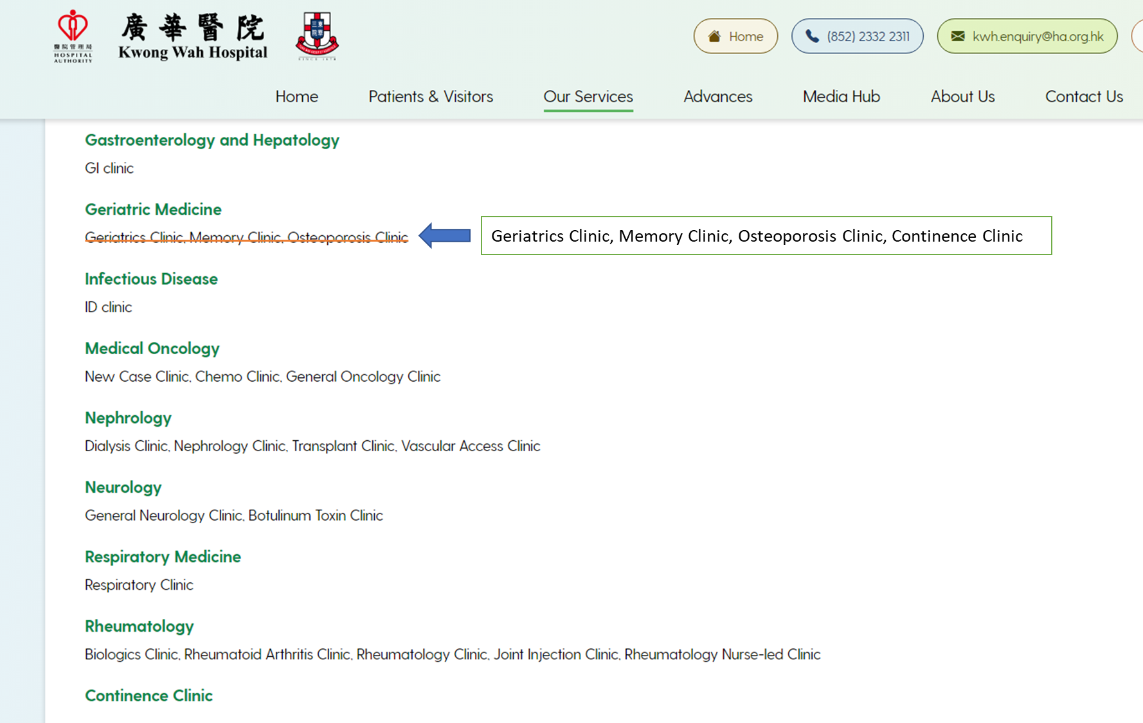
https://kwh.9u1.net/Services/Medicine-And-Geriatrics.html
done
Geriatrics Clinic, Memory Clinic, Osteoporosis Clinic, Continence Clinic

Slide 7
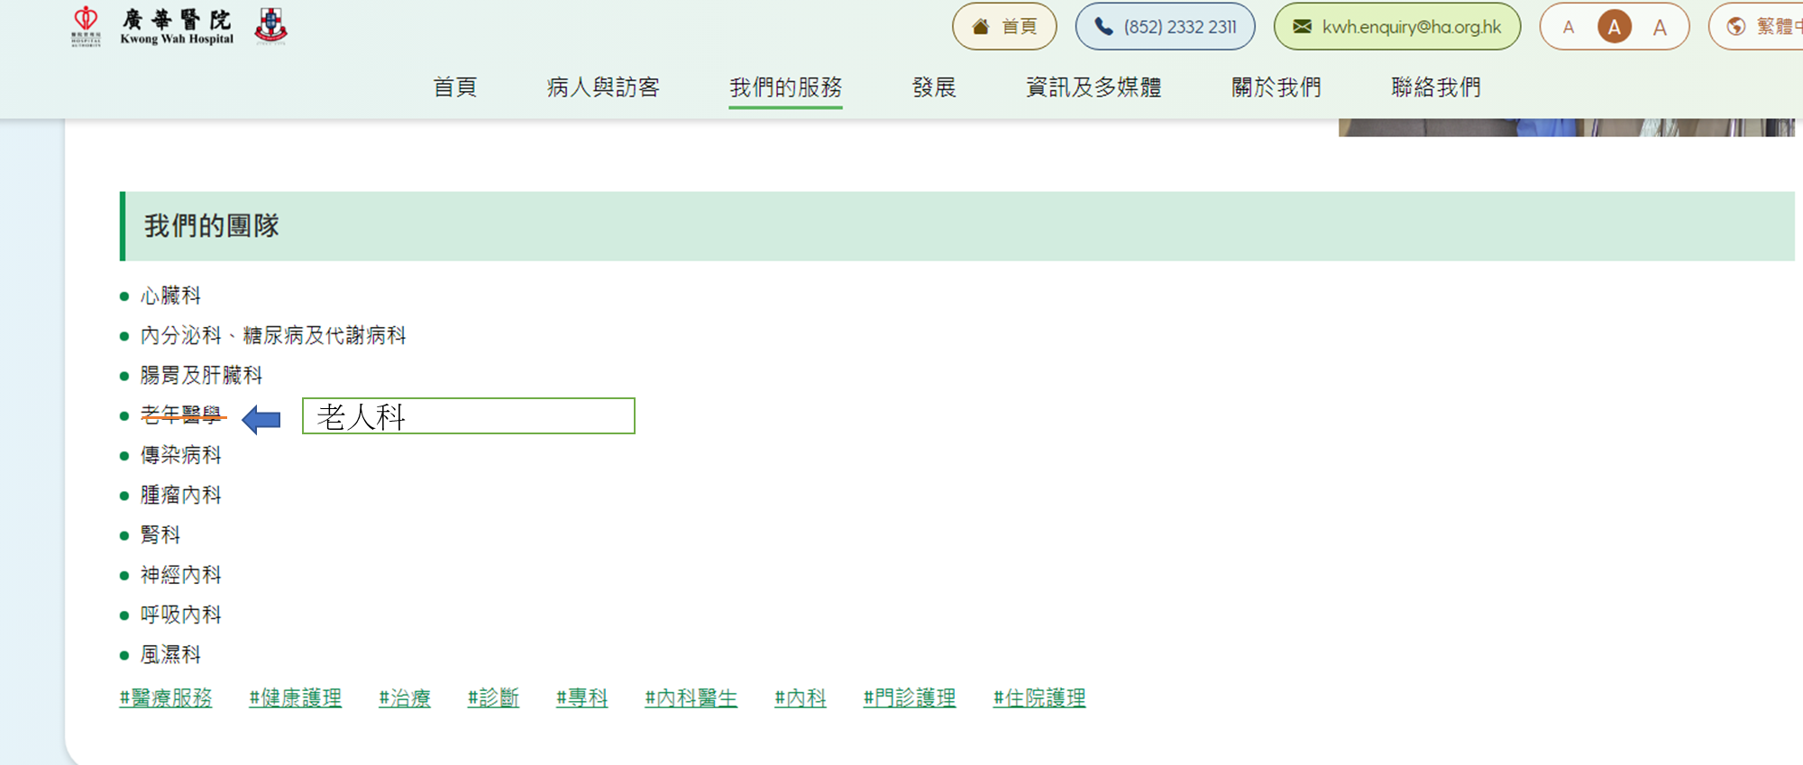
https://kwh.9u1.net/Services/Medicine-And-Geriatrics.html
done
繁體中文&简体中文:老人科

Slide 8
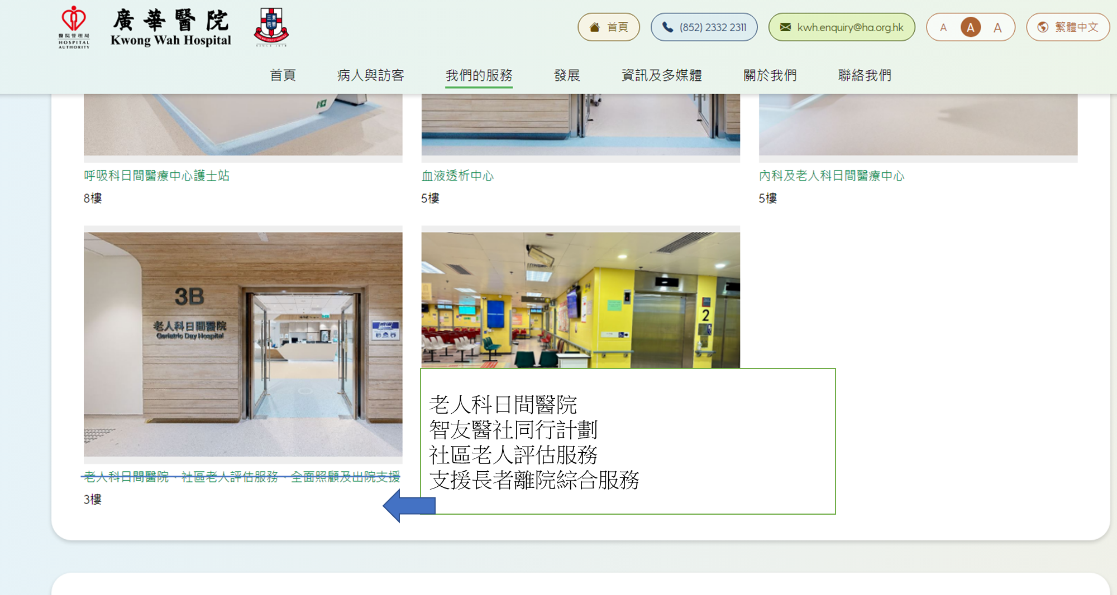
https://kwh.9u1.net/Services/Medicine-And-Geriatrics.html
done
繁體中文:
老人科日間醫院
智友醫社同行計劃
社區老人評估服務
支援長者離院綜合服務
简体中文:
老人科日间医院
智友医社同行计划
社区老人评估服务
支援长者离院综合服务

Slide 9
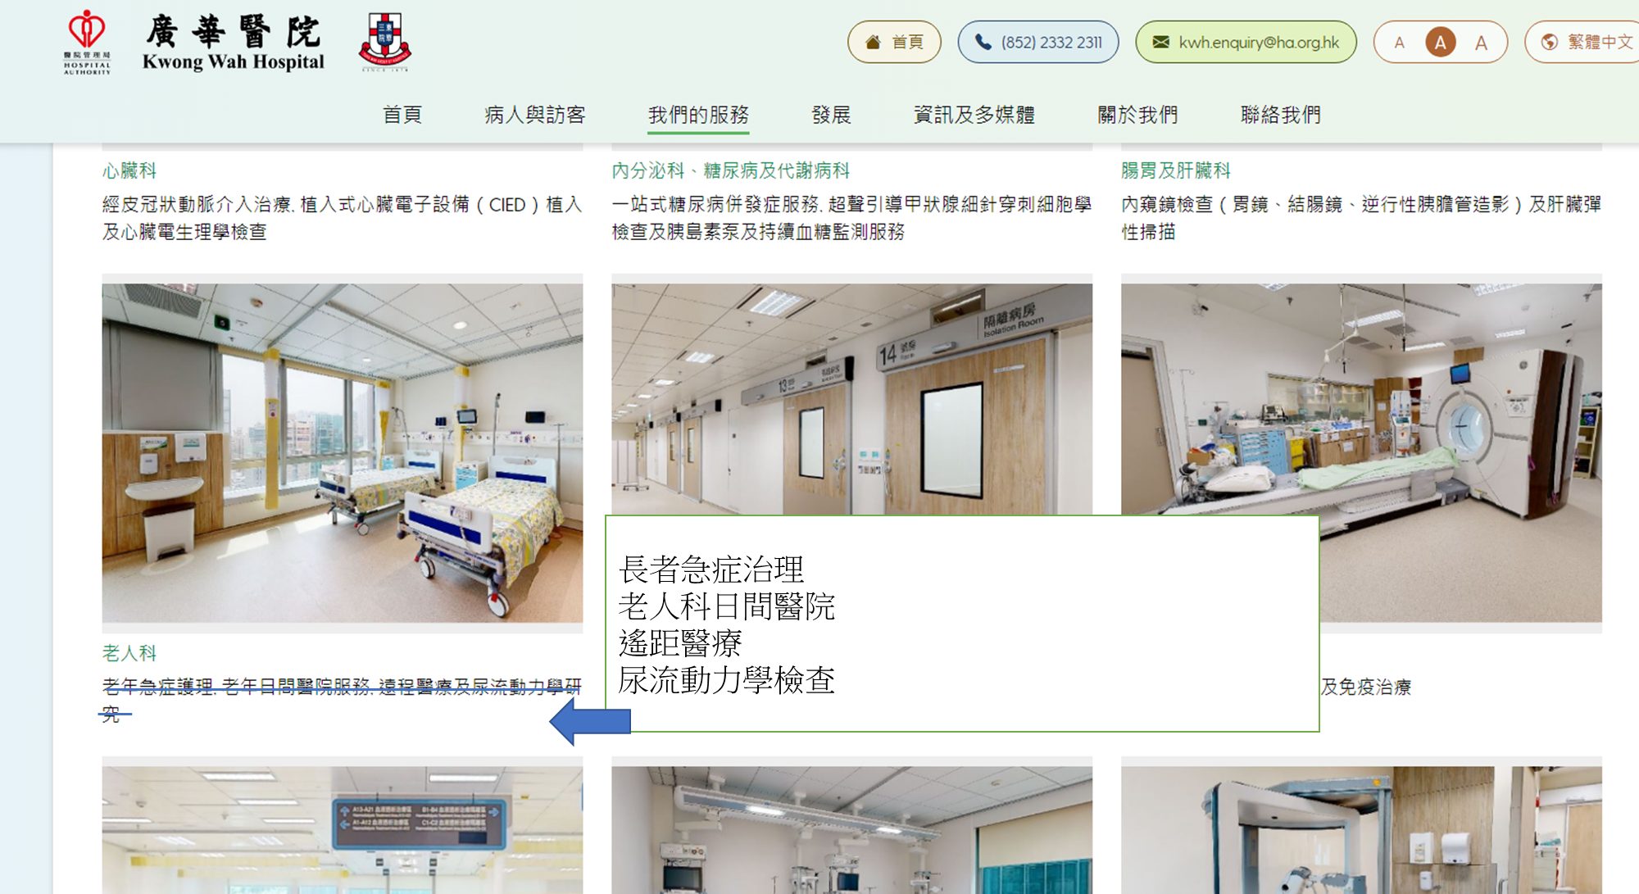
https://kwh.9u1.net/Services/Medicine-And-Geriatrics.html
done
繁體中文:
長者急症護理
老人科日間醫院
遙距醫療
尿流動力學檢查
简体中文:
长者急症护理
老人科日间医院
遥距医疗
尿流动力学检查

Slide 10
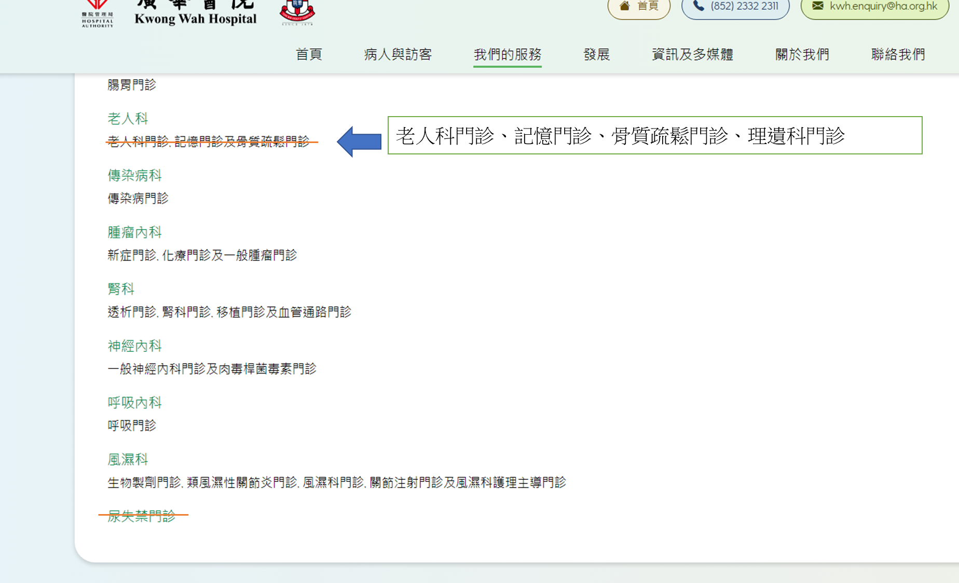
https://kwh.9u1.net/Services/Medicine-And-Geriatrics.html
done
繁體中文: 老人科門診、記憶門診、骨質疏鬆門診、理遺科門診
简体中文: 老人科门诊、记忆门诊、骨质疏松门诊、理遗科门诊

Slide 11
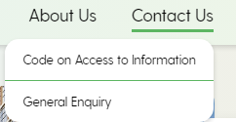
這目錄的兩個選項排序更新為
done
英文版
General Enquiry
Code on Access to Information
繁體中文版
一般查詢
公開資料守則
簡體中文版
一般查詢
公開資料守則
2024-12-05

Slide 12
這目錄的兩個選項排序更新為
done
英文版
General Enquiry
Code on Access to Information
繁體中文版
一般查詢
公開資料守則
簡體中文版
一般查詢
公開資料守則
2024-12-05

Slide 13

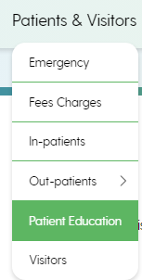
Logo合併為一，並只提供顯示功能
done
更新Patient Education(病人健康教育)為鏈結:
英文版: https://www21.ha.org.hk/smartpatient/SPW/en-us/Home/
繁體中文版:https://www21.ha.org.hk/smartpatient/SPW/zh-HK/Home/
簡體中文版:https://www21.ha.org.hk/smartpatient/SPW/zh-cn/Home/
2024-12-05

Slide 14
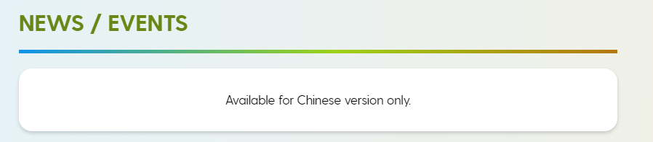
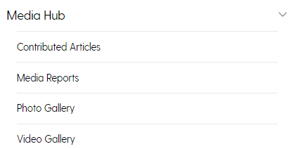
https://kwh.9u1.net/
done
圖中頁面及首頁的News/Event
顯示中文版內容
標明為”Only Chinese Version”

Slide 15
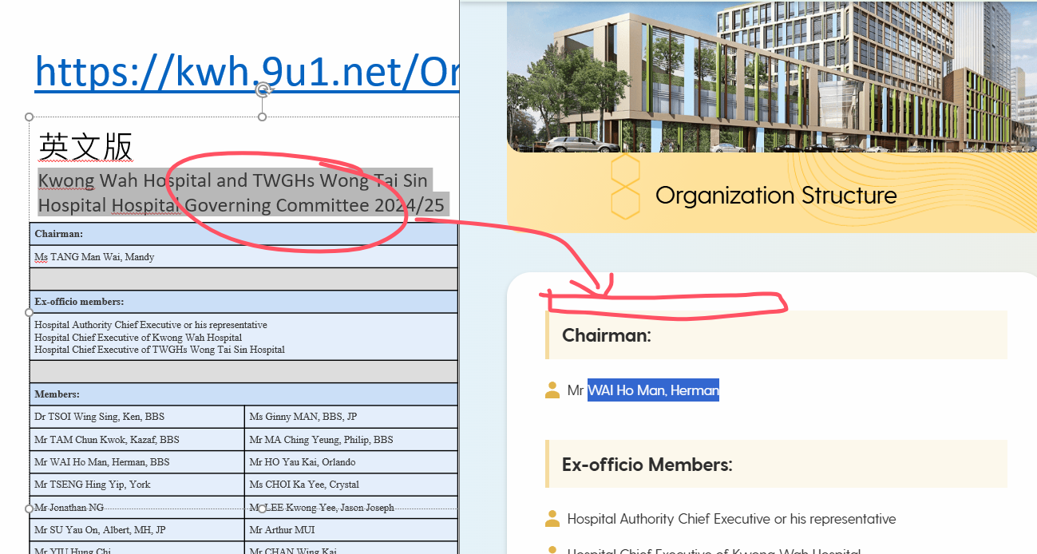
https://kwh.9u1.net/Organization-Structure.html
done
英文版
Kwong Wah Hospital and TWGHs Wong Tai Sin Hospital Hospital Governing Committee 2024/25
中文版(繁體&簡體)
廣華醫院及東華三院黃大仙醫院醫院管治委員會2024/2025
Chairman:
Ms TANG Man Wai, Mandy
Ex-officio members:
Hospital Authority Chief Executive or his representative Hospital Chief Executive of Kwong Wah Hospital Hospital Chief Executive of TWGHs Wong Tai Sin Hospital
Members:
Dr TSOI Wing Sing, Ken, BBS | Ms Ginny MAN, BBS, JP
Mr TAM Chun Kwok, Kazaf, BBS | Mr MA Ching Yeung, Philip, BBS
Mr WAI Ho Man, Herman, BBS | Mr HO Yau Kai, Orlando
Mr TSENG Hing Yip, York | Ms CHOI Ka Yee, Crystal
Mr Jonathan NG | Mr LEE Kwong Yee, Jason Joseph
Mr SU Yau On, Albert, MH, JP | Mr Arthur MUI
Mr YIU Hung Chi | Mr CHAN Wing Kai
Ms YIP Siu Lai, Queenie | Ms Patricia Joy SHIH
主 席：
鄧明慧女士
當然成員：
醫院管理局行政總裁或其代表 廣華醫院醫院行政總監 東華三院黃大仙醫院醫院行政總監
成員：
蔡榮星博士 BBS | 文頴怡小姐 BBS, JP
譚鎮國先生 BBS | 馬清揚先生 BBS
韋浩文先生 BBS | 何猷啟先生
曾慶業先生 | 蔡加怡女士
伍怡先生 | 李曠怡先生
蘇祐安先生 MH, JP | 梅慶堯先生
姚鴻志先生 | 陳永佳先生
葉笑麗女士 | 施慧明女士

Slide 16
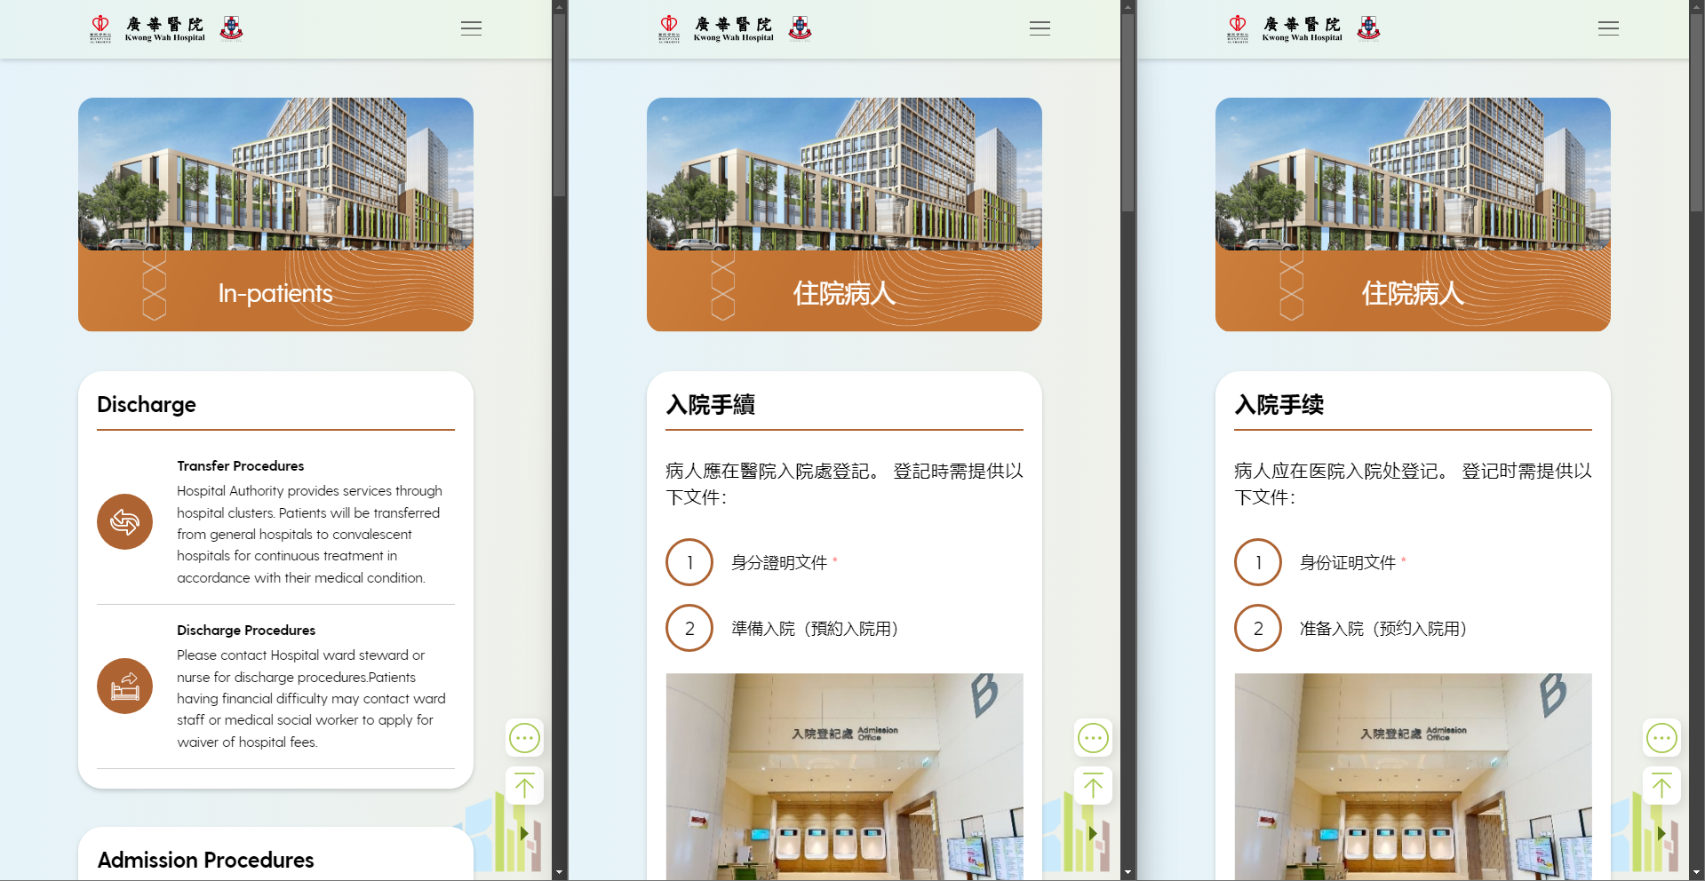
https://kwh.9u1.net/In-patients.html?lang=en
done
英文版同中文版排版不一致
排版跟中文版

Slide 17
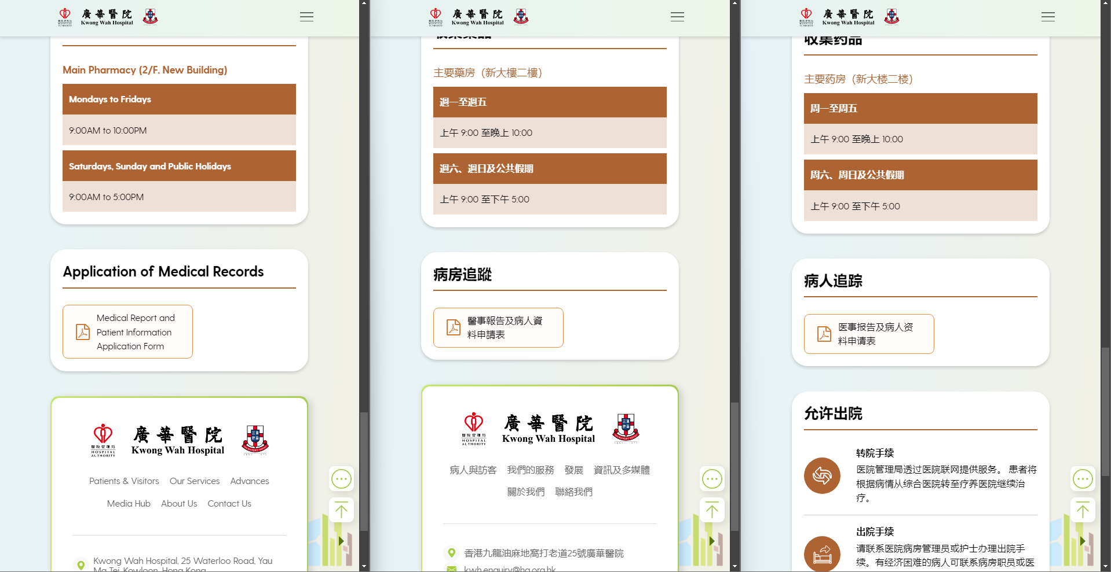
https://kwh.9u1.net/In-patients.html?lang=en
done
意思不對

Slide 18
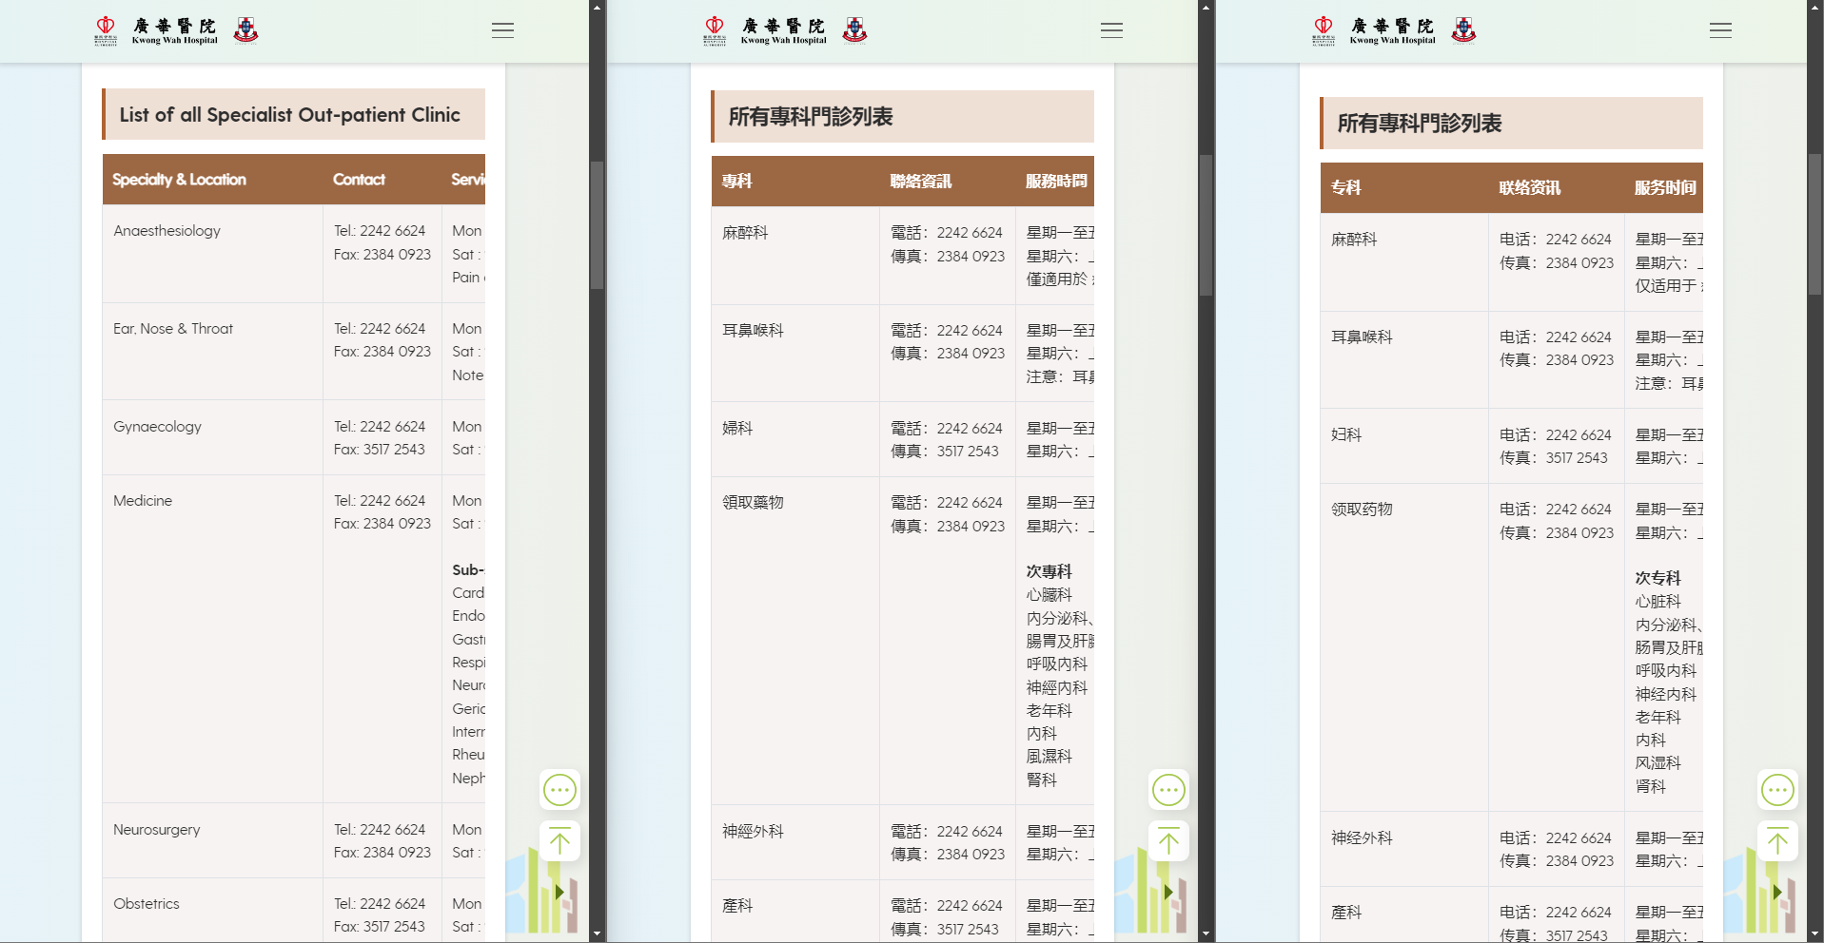
https://kwh.9u1.net/Specialist-Out-patient.html?lang=en
done
好像有點不太像是簡體?
內科
內科

Slide 19
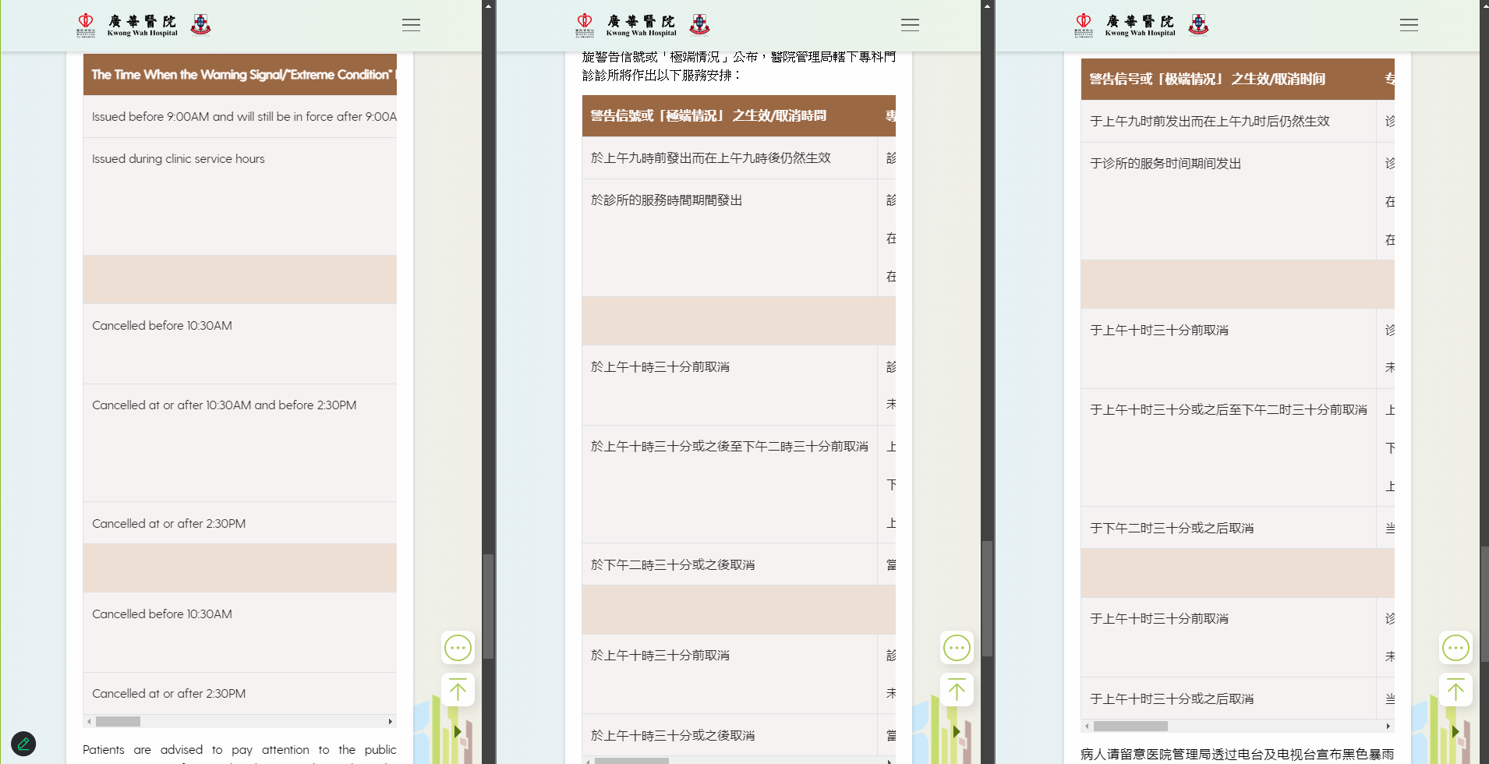
https://kwh.9u1.net/Specialist-Out-patient.html?lang=en
done
英文版同中文版內容不一樣
跟中文版
內科
內科

Slide 20
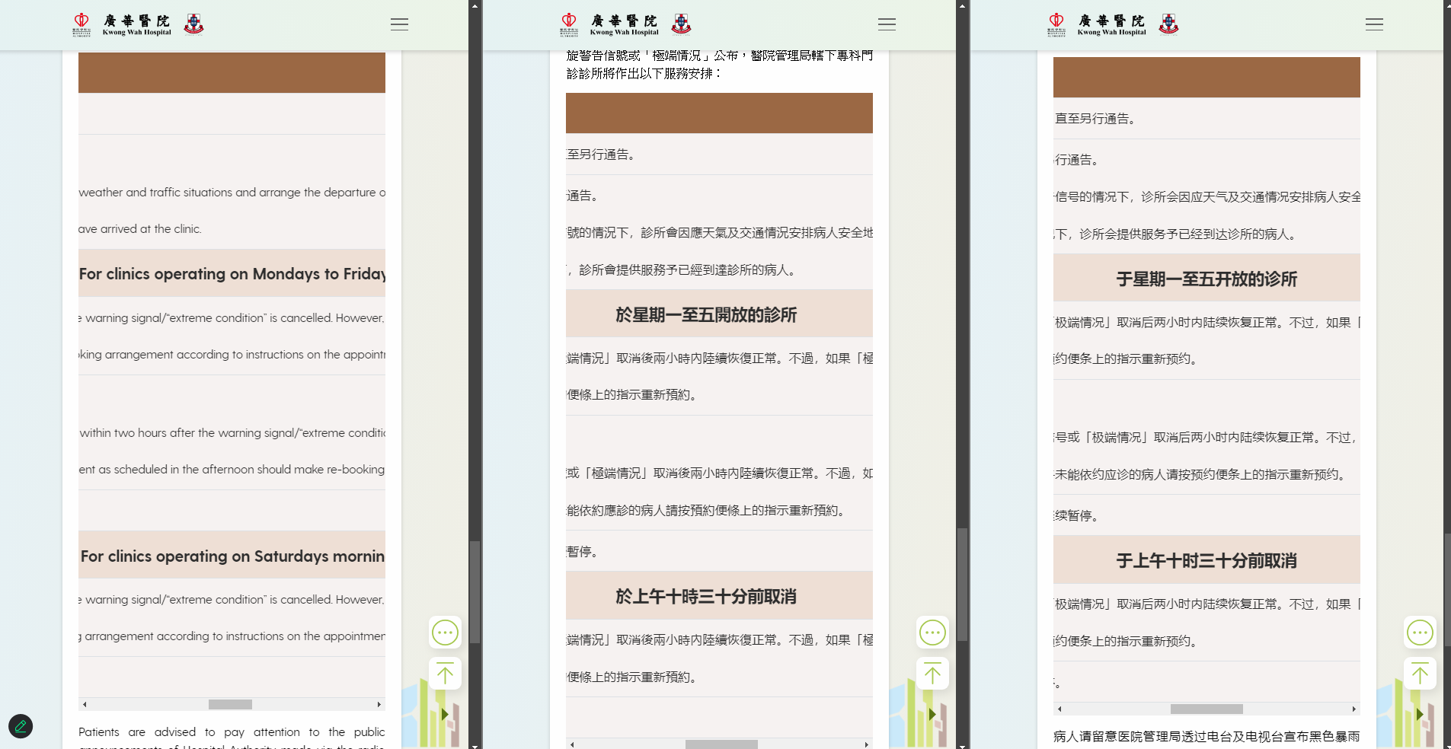
https://kwh.9u1.net/Specialist-Out-patient.html?lang=en https://www.ha.org.hk/visitor/ha_visitor_index.asp?Content_ID=248298&Lang=CHIB5&Dimension=100&Parent_ID=10053&Ver=HTML
done
英文版同中文版內容不一樣
跟英文版

Slide 21
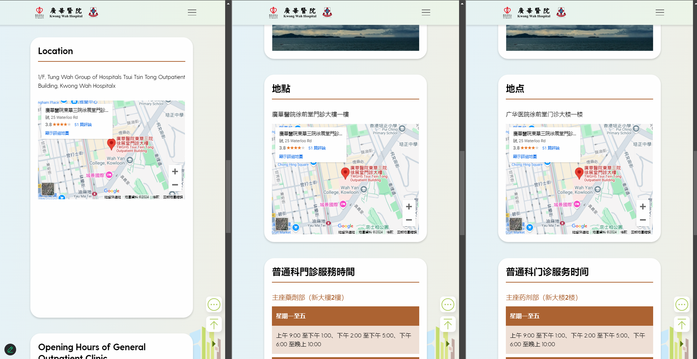
https://kwh.9u1.net/General-Out-patient.html
done
英文版多了x字
請移除
為什麼有這麼大的空白位置?

Slide 22
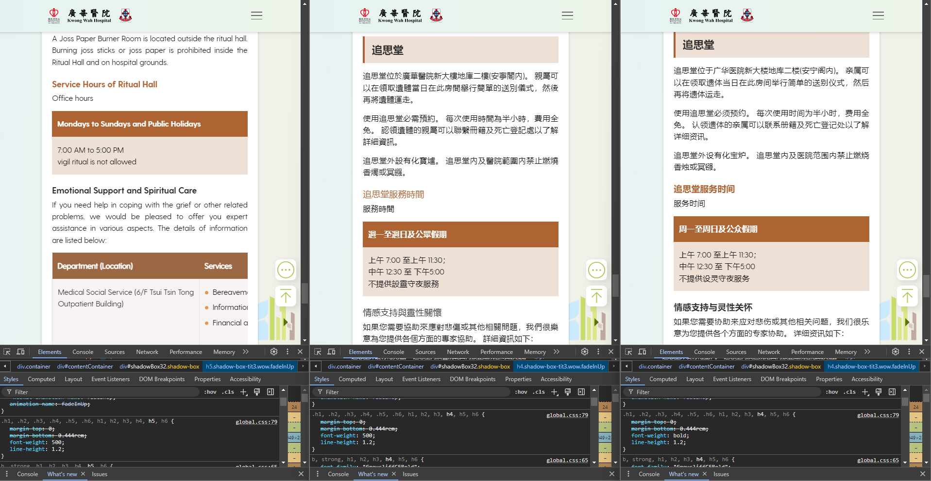
https://kwh.9u1.net/Visitors.html?lang=en
done
請粗體

Slide 23
2024-12-09

Slide 24
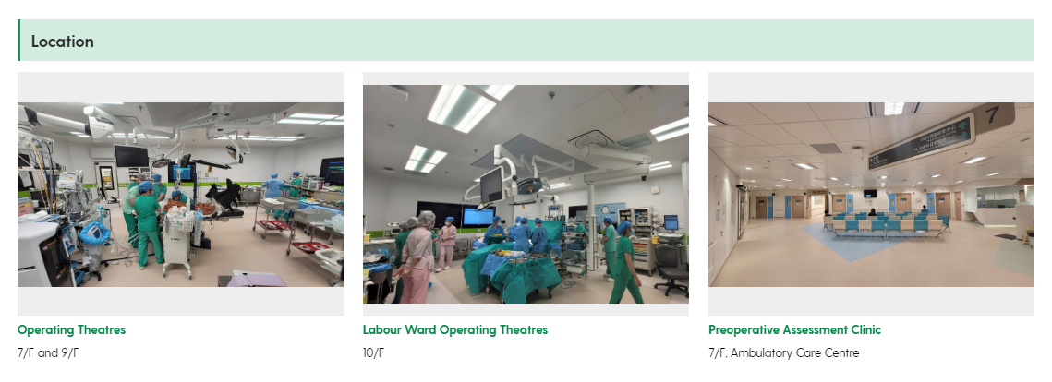
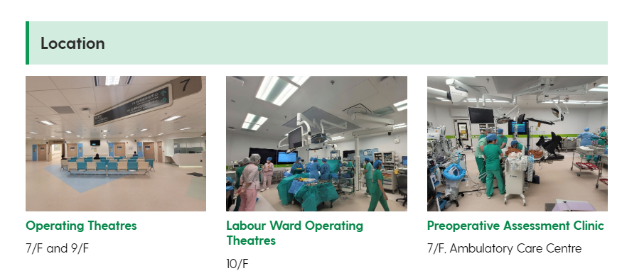
https://kwh.9u1.net/Services/Anaesthesiology-Operating-Theatre-Services.html
位置錯亂
done
Top priority
1
2
3
本來位置
現在錯誤位置

Slide 25
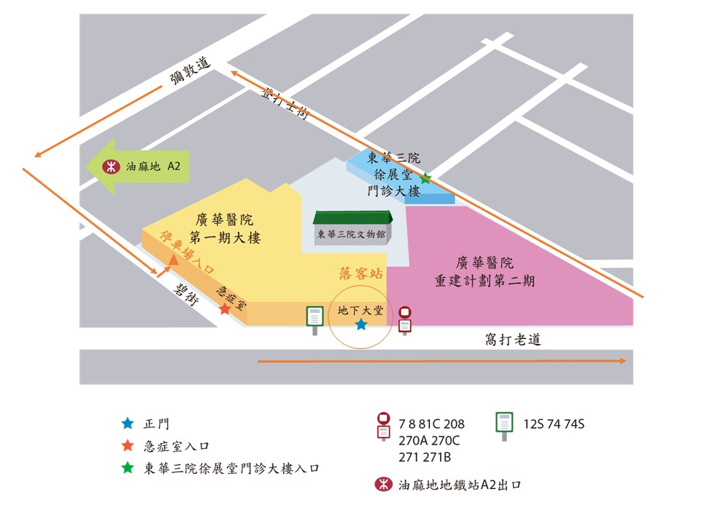
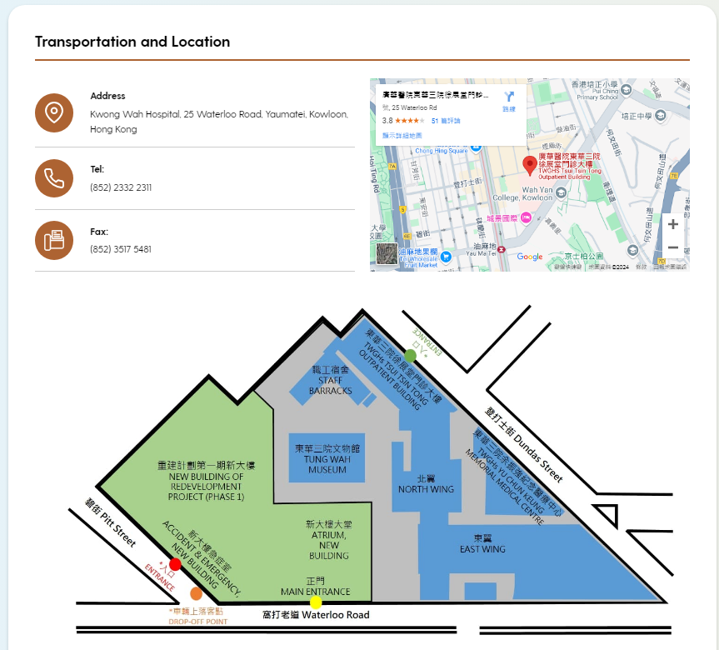
Visitors
done
更換圖片
Webpage:
https://kwh.9u1.net/Visitors.html
Google Drive:
https://drive.google.com/file/d/1MtCQahJtxG3BLM_bDRnYLkD_Q33edeN8/view?usp=drive_link

Slide 26
Redevelopment Project
done
Webpage:
https://kwh.9u1.net/Redevelopment-Project.html
Google Drive:
https://docs.google.com/document/d/1zHxkurNvZXPqJfGIZEu7P3TeAEc8VXa6/edit?usp=drive_link&ouid=111471142683719346953&rtpof=true&sd=true

Slide 27
Outreach Service (Nursing)
done
Change the PDF content to website content as following 3 slides

Slide 28
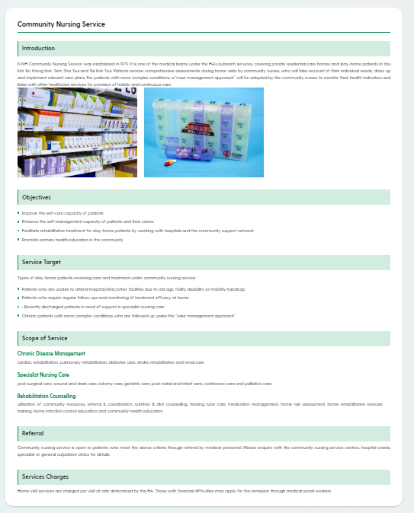

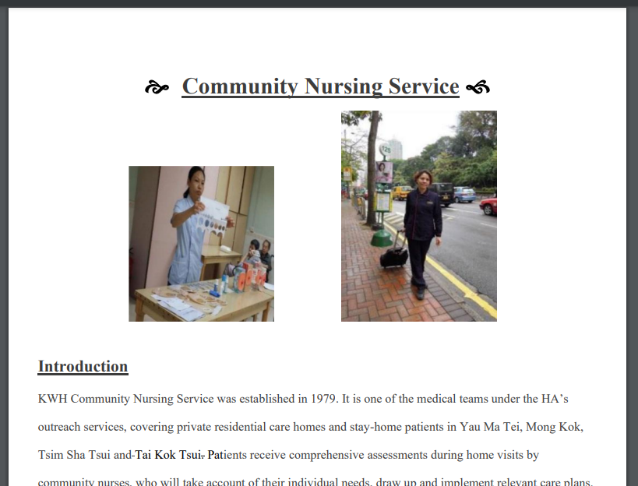
https://kwh.9u1.net/Services/Community-Nursing-Service.html
done

Slide 29
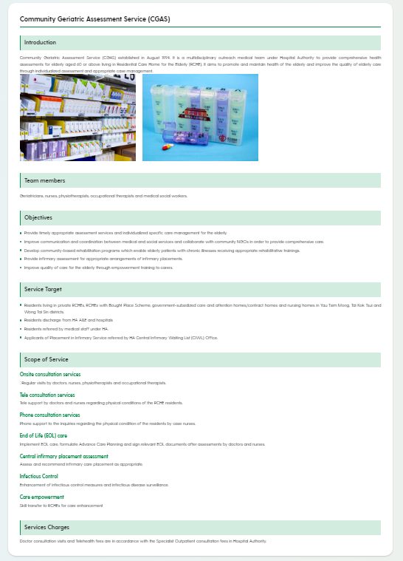
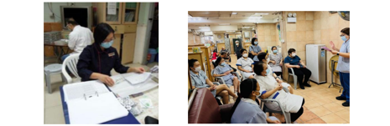
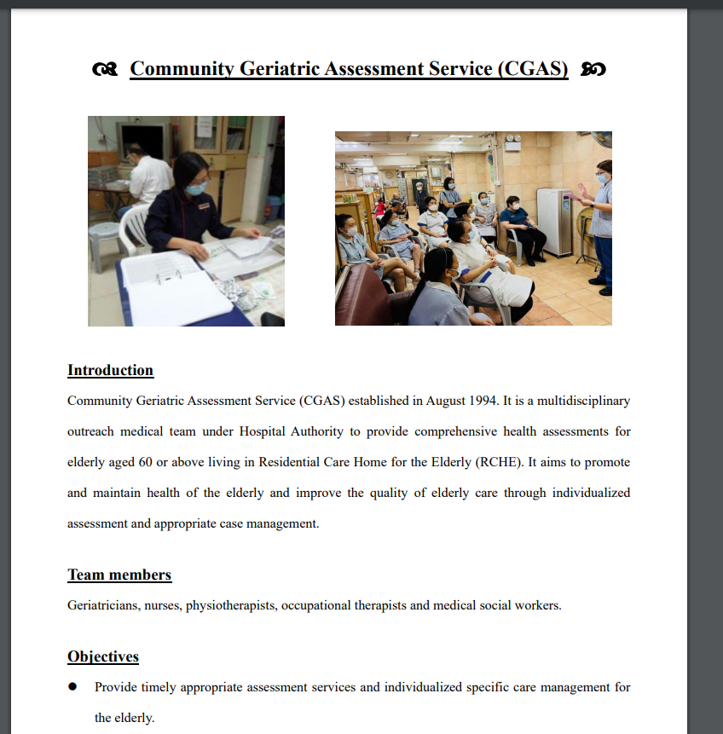
https://kwh.9u1.net/Services/Community-Nursing-Service.html
done

Slide 30
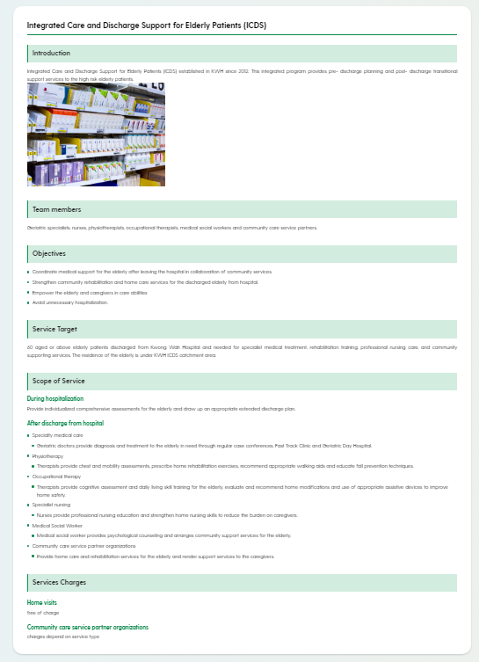
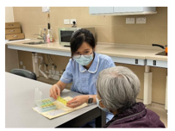
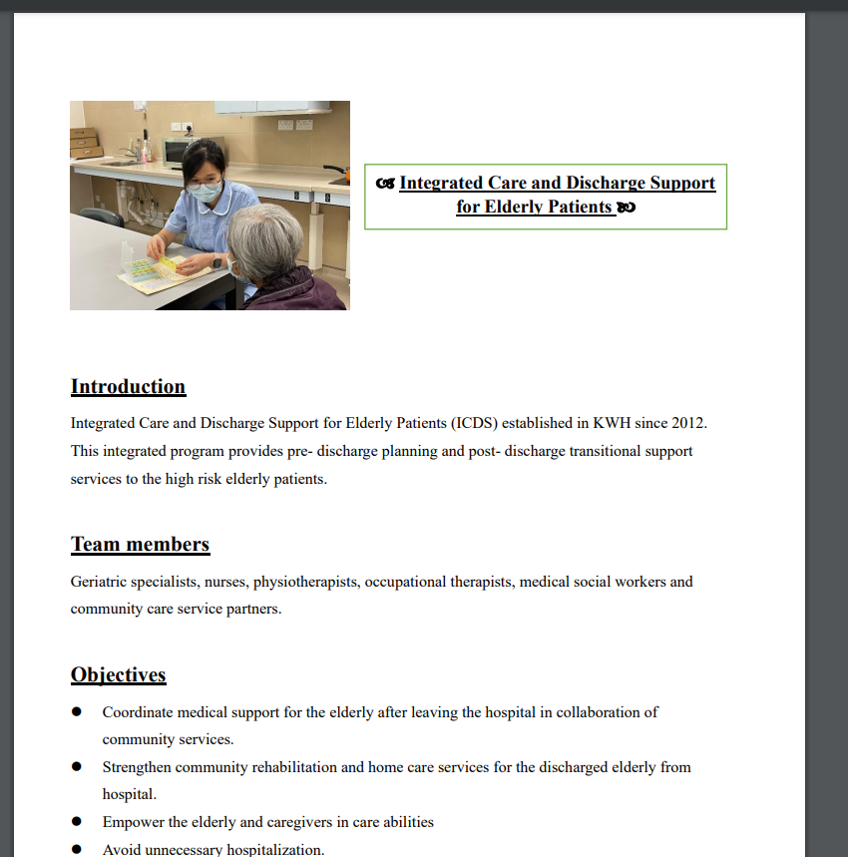
https://kwh.9u1.net/Services/Community-Nursing-Service.html
done

Slide 31
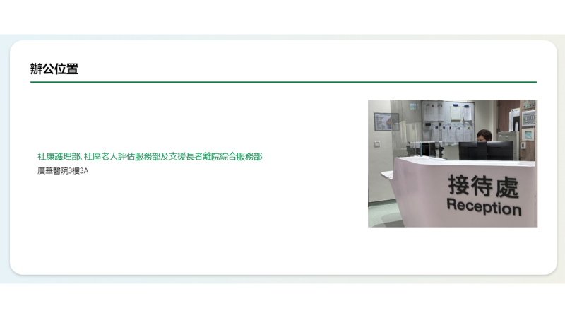
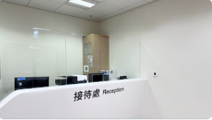
https://kwh.9u1.net/Services/Community-Nursing-Service.html
Change the layout to be “left words and right photo”
done

Slide 32
History
done
新增內容
Webpage:
https://kwh.9u1.net/history.html
Google Drive:
https://docs.google.com/document/d/1DBnTfKs9EKeRaqg3s4W7FpYkLUf1WDkr/edit?usp=drive_link&ouid=111471142683719346953&rtpof=true&sd=true

Slide 33

History
done
增加引號於此句前後
因為是對聯，想令此句看上去看是中國書法風格

Slide 34
2024-12-10

Slide 35
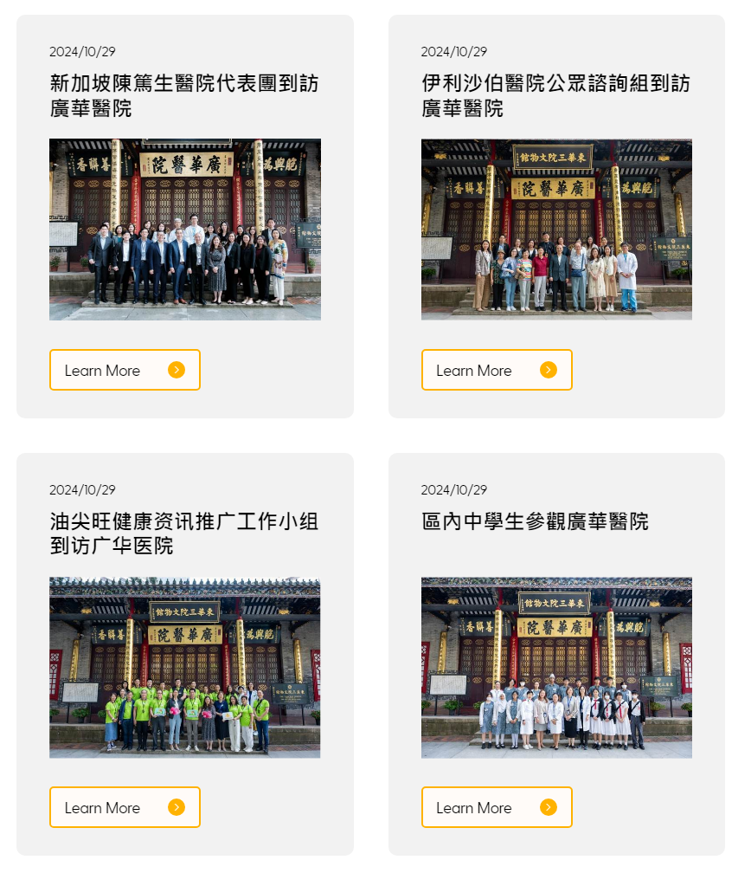
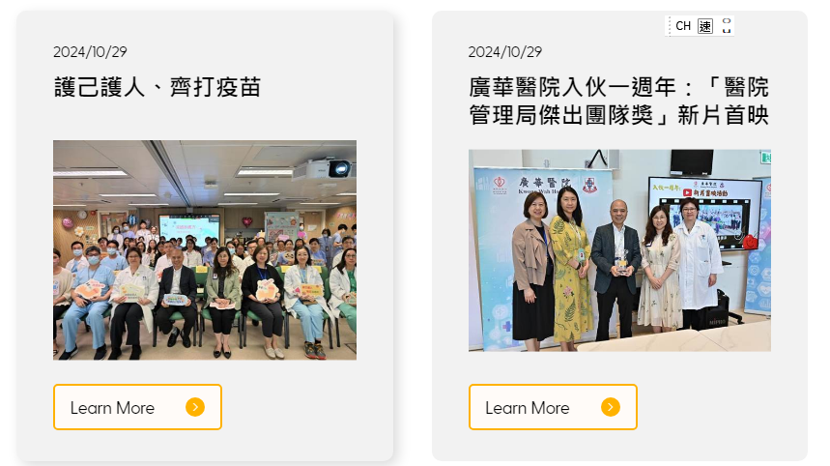
News/Events
2024-08-30
done
2024-09-04
更改日期
2024-09-19
2024-09-02
2024-09-19

Slide 36
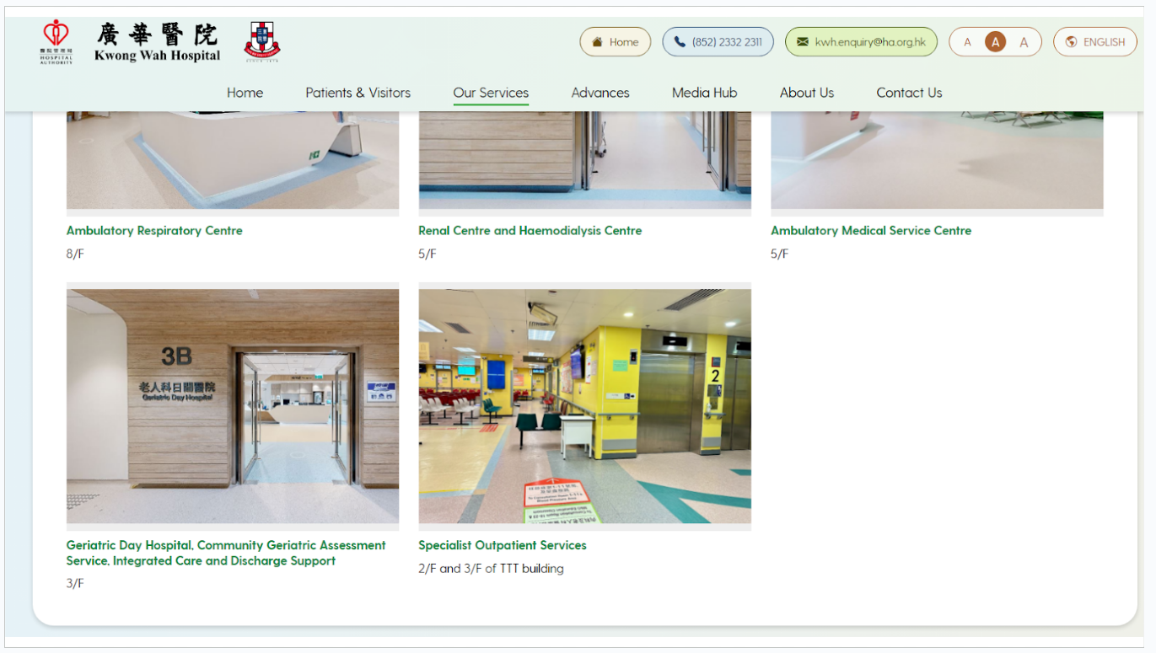
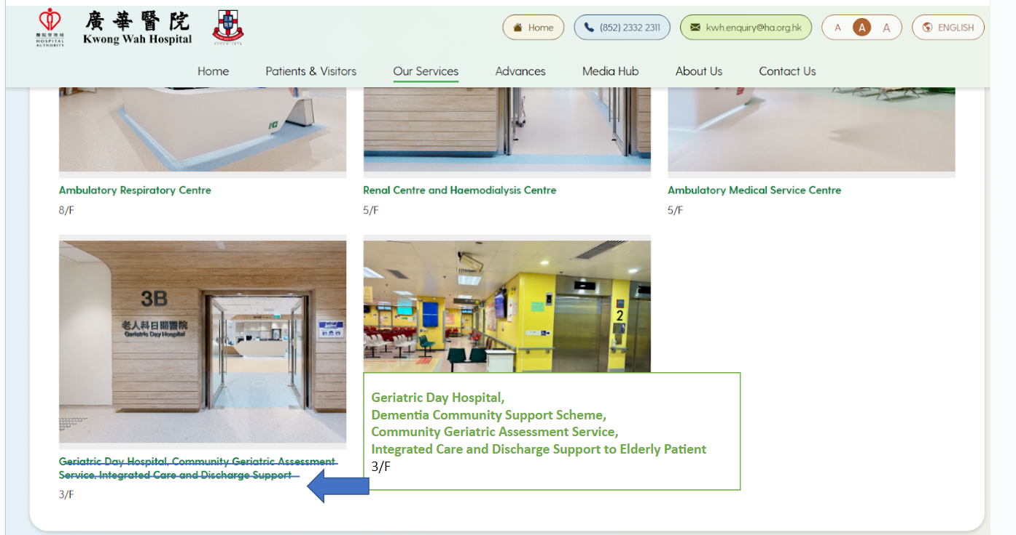
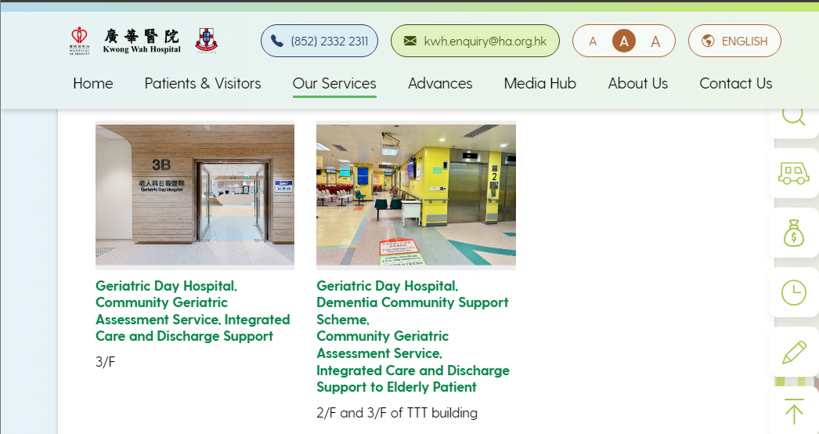
M&G
done
https://kwh.9u1.net/Services/Medicine-And-Geriatrics.html
Google Drive: Related to https://docs.google.com/presentation/d/1jEgqIGIOxVzFIe07Xeeyc0rnGQsrS4zA/edit#slide=id.g31c3918784f_1_25
(Slide 15-20)
更新錯誤(所有語言)
是更改左邊3B的文字
現在錯誤改了中間的
Before
Request
Now

Slide 37
2024-12-12

Slide 38
Overview https://kwh.9u1.net/overview.html
done
英文版:
The proposal to build a charitable hospital on Kowloon side in line with the Tung Wah Group of Hospitals(TWGHs) was realized when the first Kwong Wah Hospital(KWH) with 72 beds was completed in 1911. The name “Kwong Wah” was chosen to imply the extension of welfare to the Chinese residents in Hong Kong. In 1991, KWH joined Hospital Authority(HA) which had assumed management responsibilities of the Hospital thereafter. Since then, massive plans to change, transform and develop the Hospital were initiated in view to upgrade the quality and efficiency of services. To meet healthcare and service development needs, KWH is undergoing a Redevelopment Project.
The Phase 1 building of Redevelopment Project had completed in December 2022 and had commissioned in Phases since the 2Q-2023. The three main themes of the Redevelopment Project of Kwong Wah Hospital is Smart, Healing and Sustainability with a slogan of “We Care with Heritage and Innovation”. Additional services such as ambulatory centres, diagnostic and radiology facilities and endoscopy centre etc. had commenced operations and such service areas had expanded around 21,000 square meters. Not only does the Phase 1 building provide one-stop ambulatory services, but also have an additional medical oncology unit and the expansion of integrated Chinese and Western medicine services for providing emergency, inpatient, specialist out-patient and ambulatory services to the community. There are also additional operating theatres (additional 4 in Phase 1) which is also the first public hospital with full application of Modular Operation Theatre.
The Phase 1 building is with full coverage of 5G network, which is the first public hospital to deploy full coverage of 5G network providing free Wi-Fi service to the public. This measures have brought smart hospital from concept to reality. Besides, robots and Command Centre are also adopted to enhance operational efficiency of the Hospital. Phase 2 demolition works had started in late July, and was scheduled to be completed in 2027.
中文版:
廣華醫院建於1911年，早期設有病床72張。「廣華」的意義標誌著東華三院的醫療福利能「廣」濟「華」胞。廣華醫院自1991年12月1日起由醫院管理局管理，成為醫管局轄下四十三間公立醫院之一。其後由於人口不斷激增，以致醫院原有醫療設施及地方不敷應用，醫院經歷多次重建及擴建。為配合現代醫療及服務發展趨勢，廣華醫院現正進行新一期重建計劃。
第一期大樓的3個主題是智慧、醫療及可持續發展，並配合新里程標語「塑建智慧醫旅 傳繫百載仁程」，於2022年12月竣工及2023年第二季分階投入服務。第一期大樓不但提供一站式日間醫療護理服務，更新增內科腫瘤科及拓展中西醫結合服務，為社區提供急症、住院、專科門診及日間醫療服務。此外，亦增設4間手術室，是醫管局轄下第一間全面應用模塊式手術室(Modular Operation Theatre) 。
廣華醫院大樓全面覆蓋5G網絡，是醫管局轄下第一間全院鋪設5G網絡的醫院，提供免費Wi-Fi服務以支持智慧醫院發展。醫院亦引入機械人及設立中央指揮中心，透過科技提升營運效率。第二期的拆卸工作亦已於2023年7月下旬展開，第二期大樓預計於2027年竣工。

Slide 39
未完成

Slide 40
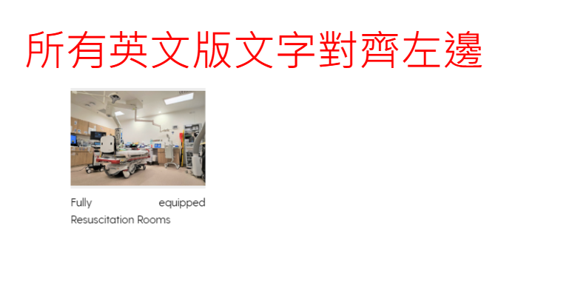

Slide 41
Award
Webpage:
https://kwh.9u1.net/Awards.html
Google Drive:
https://docs.google.com/document/d/1r65N5h3MqDEO9lqBSnHRxwMMHy8oK97U/edit?usp=drive_link&ouid=111471142683719346953&rtpof=true&sd=true

Slide 42
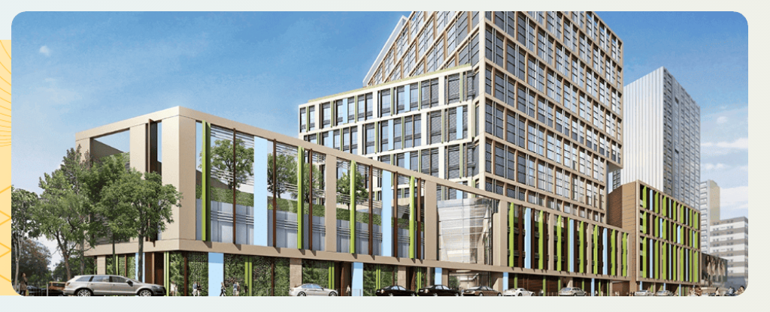
更改所有「廣華外觀模擬圖片」
現在不少地方使用著重建的模擬圖片
請更換為下列的兩張圖片其中一張(請看哪一張比較適合)
Google Drive:
https://drive.google.com/drive/folders/1MWljnnBURJCfP2n07wd2_UIRIZ9EZTaX?usp=sharing

Slide 43
待KWH覆

Slide 44
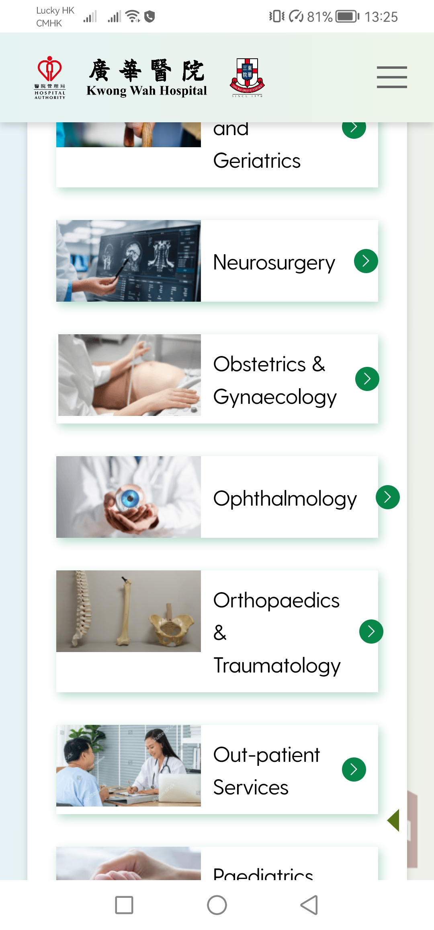


https://kwh.9u1.net/Our-Services.html
於手機版進入服務列表頁時, 因文字文度超出, 導致如下圖所示的異常
建議的解決方法是改為:
1) 以上圖下字形式處理, 但缺點是版面會變很長
2) 於手機版時直接移除不顯示圖片

Slide 45
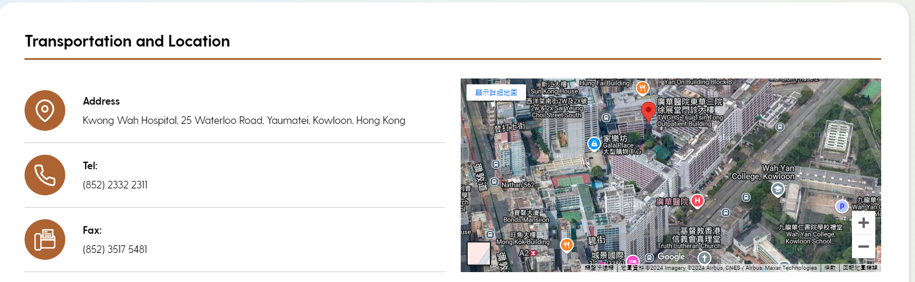
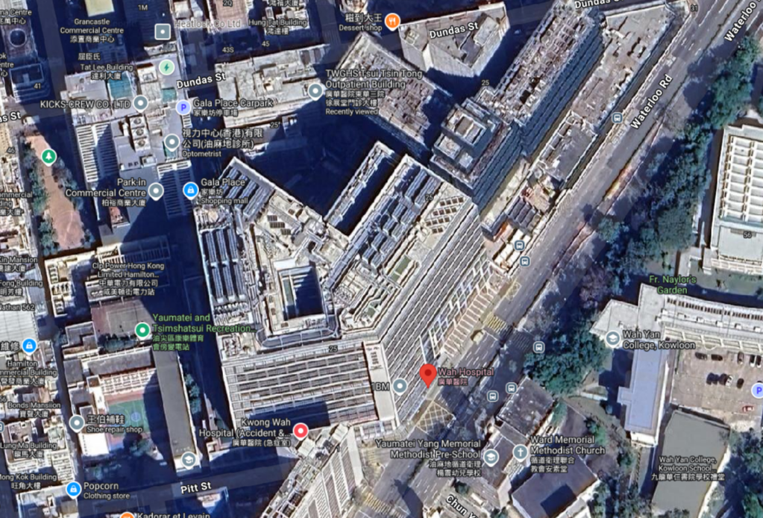
Visitor
Outdated
Currently showing on Google

Slide 46
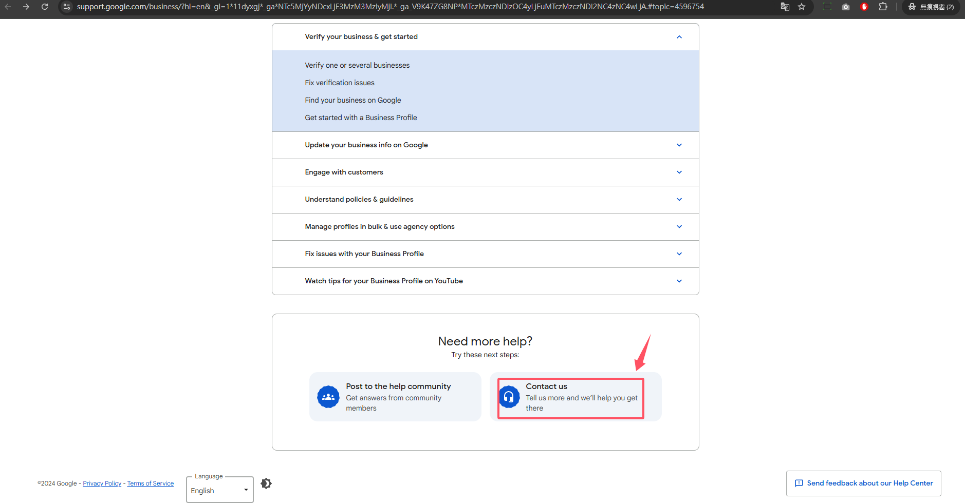
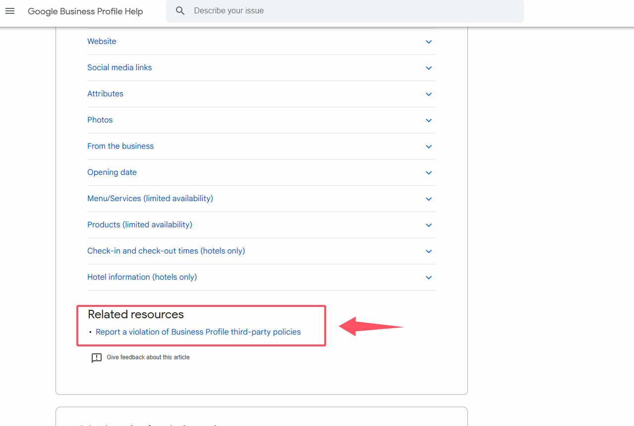
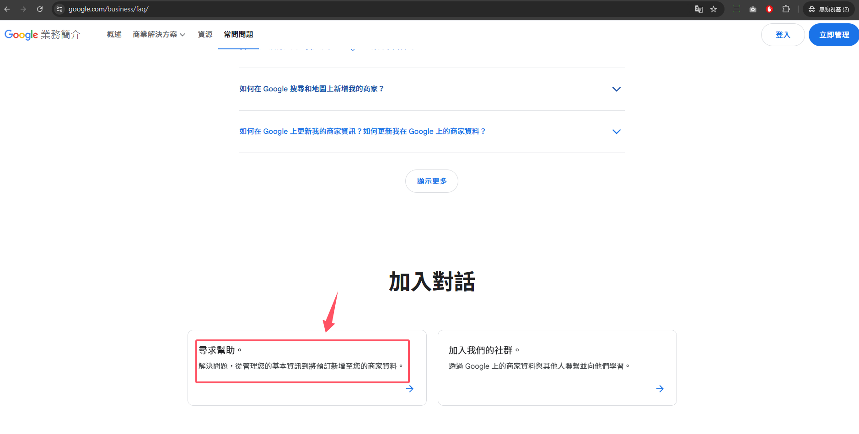
Google商家 https://support.google.com/business?sjid=4038118222477170983-AP#topic=4596754 https://www.google.com/business/faq/ https://support.google.com/business/answer/3039617?sjid=4038118222477170983-AP#zippy=%2Ccontact-number-issue https://support.google.com/business/contact/gmb_3p_complaints?sjid=4038118222477170983-AP

